Slide 1
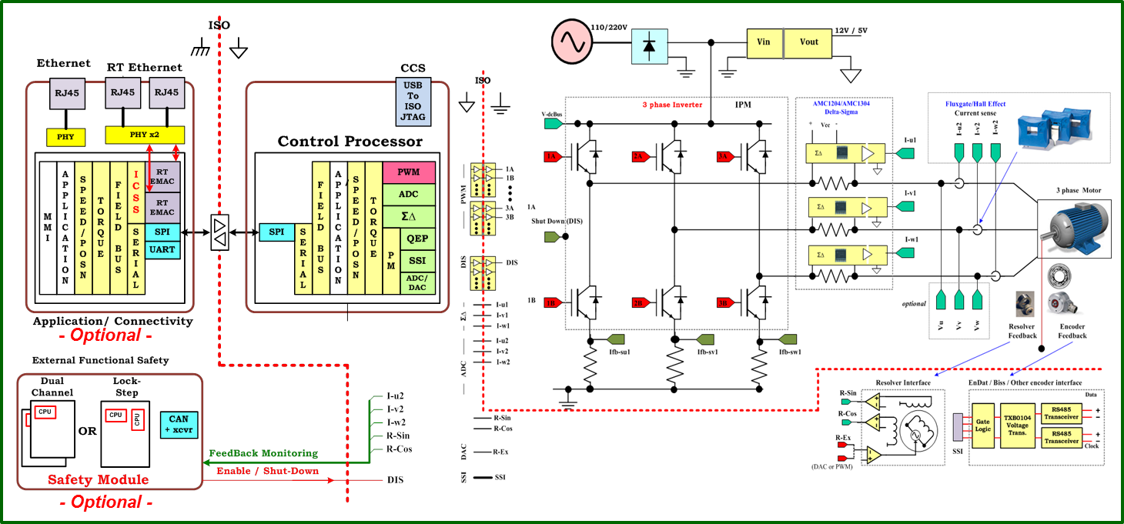

TMS320F2837xD
PMSM Servo

Slide 2
TMDXIDDK379D
TMS320F2837xD
PMSM Servo

Slide 3
Design
Specifications
Requirements
Hardware
+
Software
Analysis
Model of Real System
Sub-models
Closed loops specs.
Functions
State flow
Implementation
SIL + HIL
Test
Verification
Generated Code

Slide 4
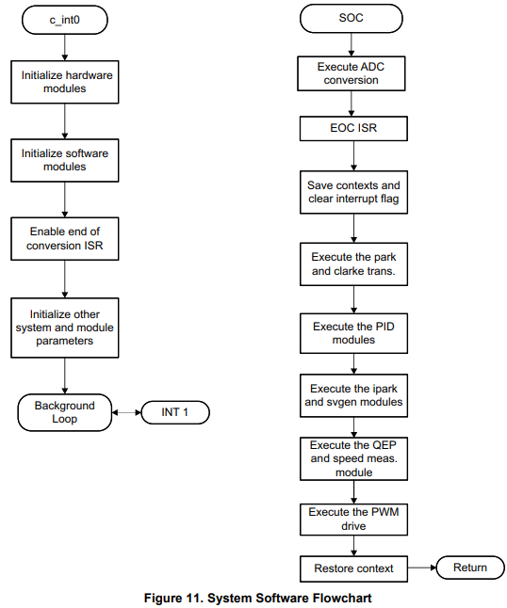
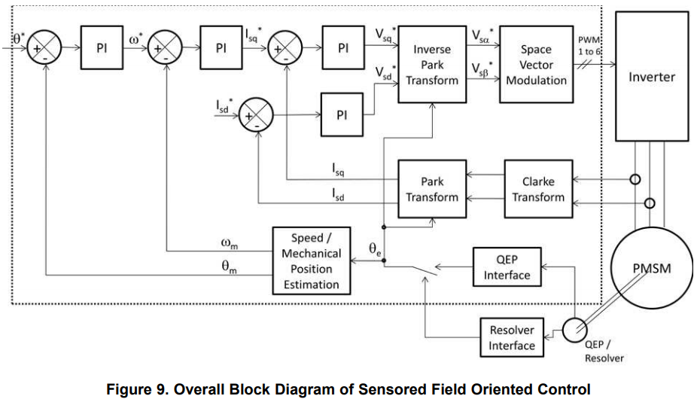
TI software strategy

Slide 5
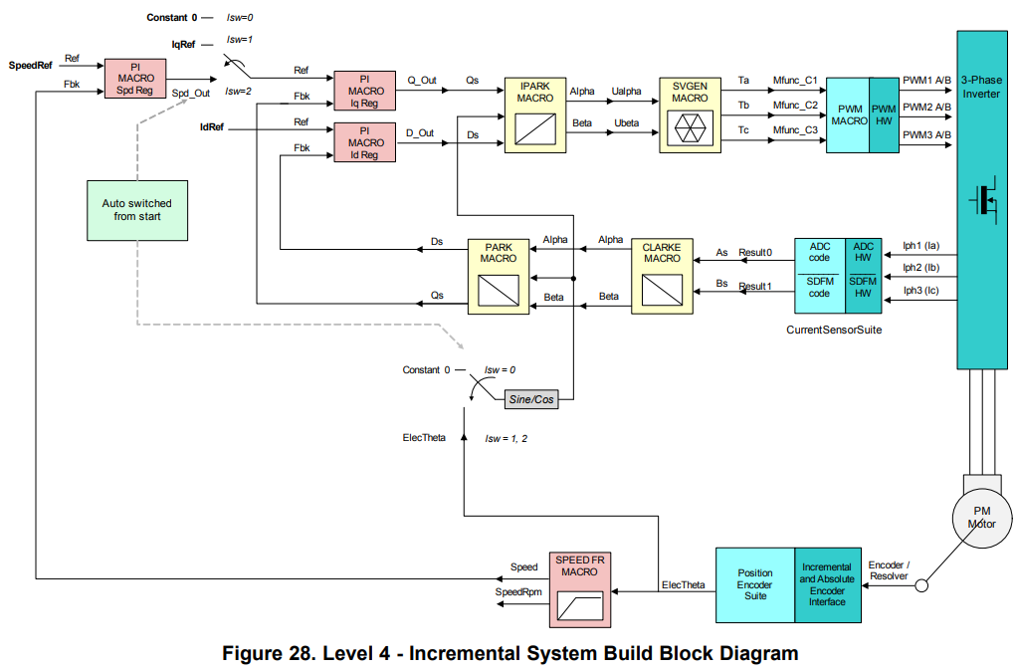
TI software strategy

Slide 6
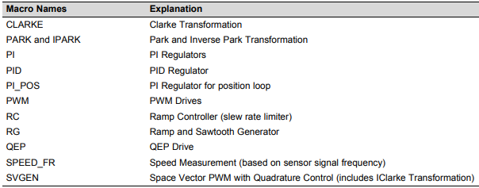
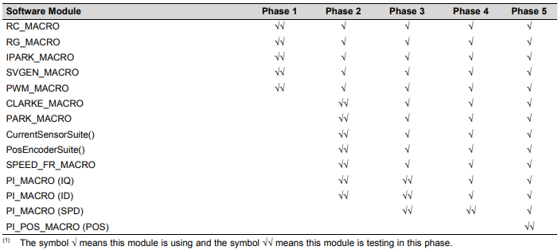
Executed macros & modules
Speed
Control
Position
Control

Slide 7
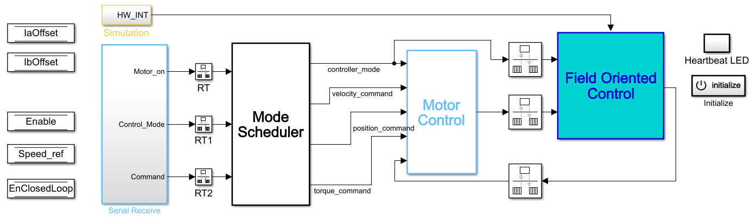
Automatic code generation with systematic approach
performance enhancing additions

Slide 8
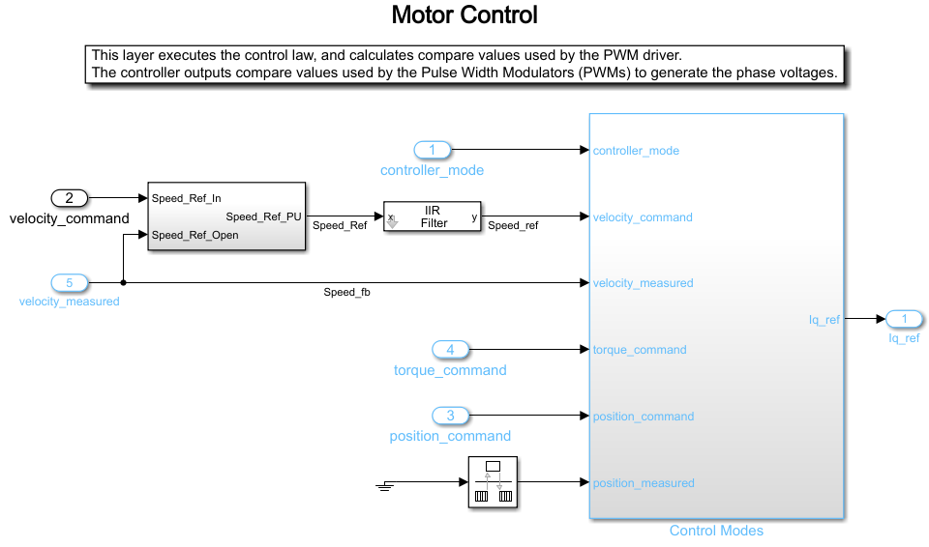
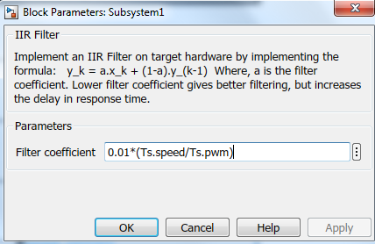
IIR Filter
for speed ref.

Slide 9
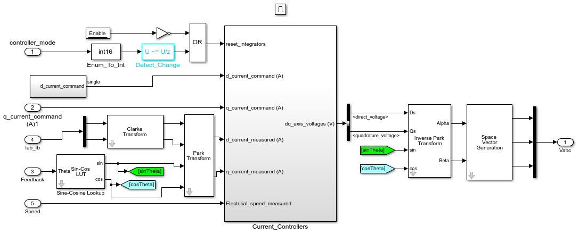
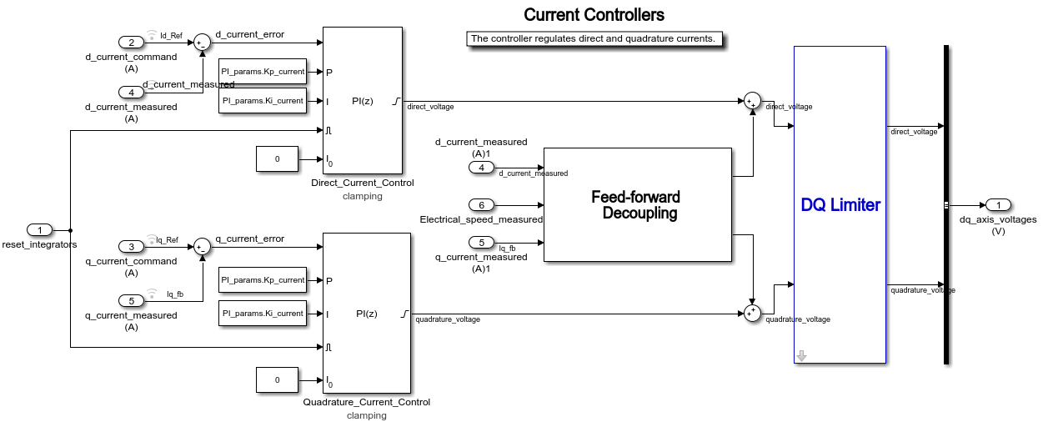
Feed Forward
Decoupling
for
Current Controller

Slide 10
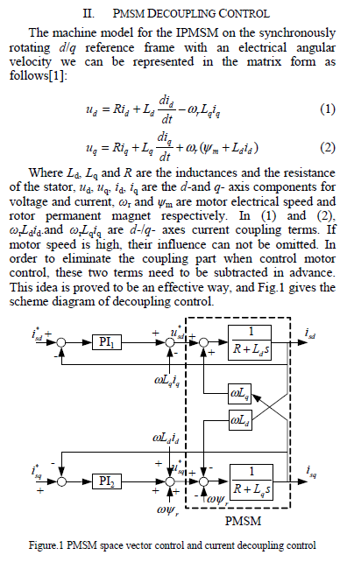
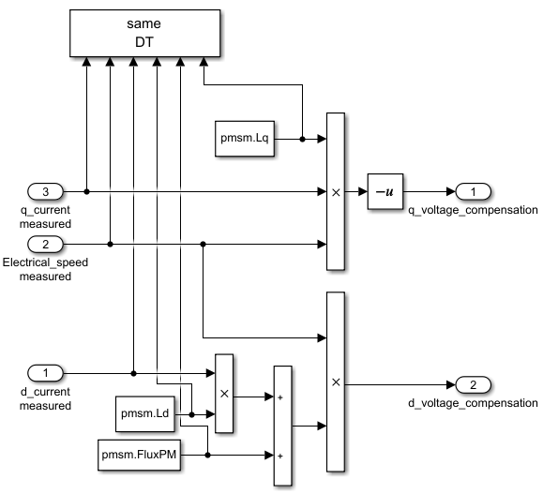

Slide 11
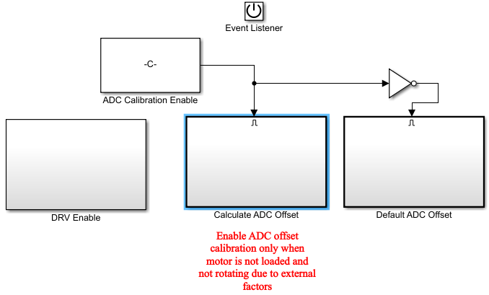
ADC offset calculator
When
initialize

Slide 12
Next job: host screen for easy control and track

